Slide 1
Dr. Sunirmal Khatua
Module 3 – AWS Global Infrastructure
By
Visvesvaraya Young Faculty Fellow, Govt. of India
Assistant Professor, University of Calcutta
Notes:
We celebrate Christmas to remember the birth of Jesus Christ

Slide 2
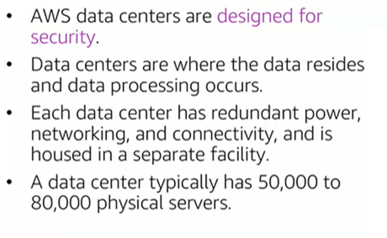
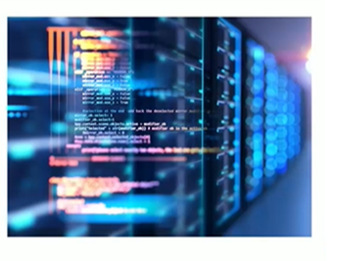
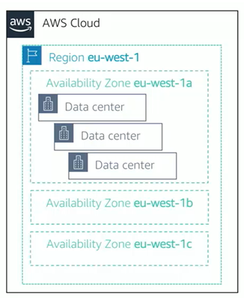
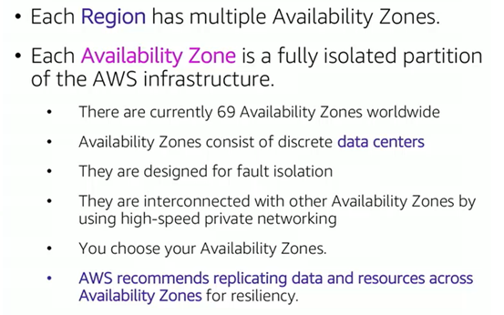
AWS Datacenters, Region and Availability Zones

Slide 3
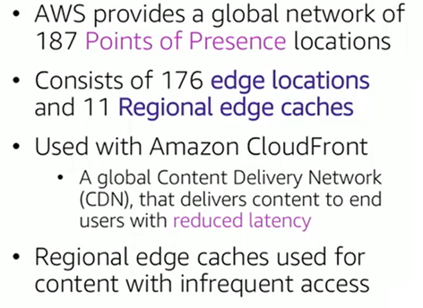
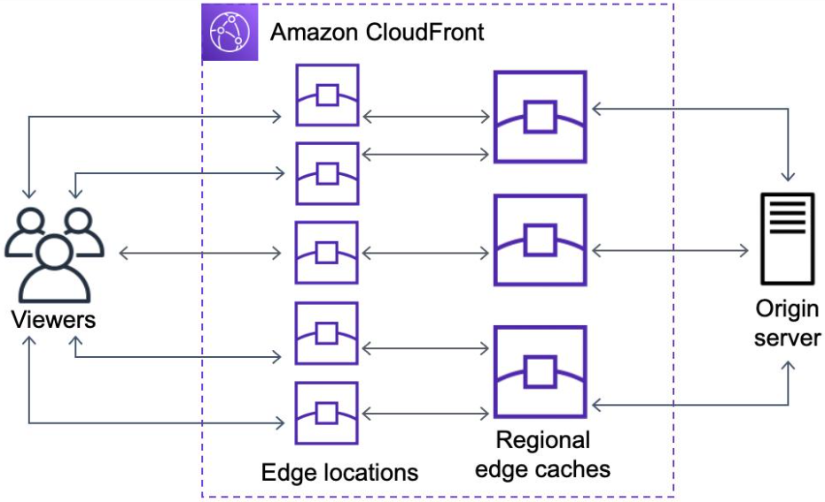
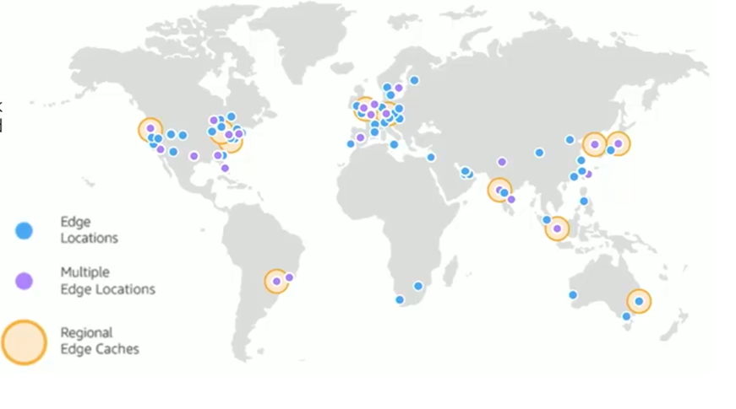
AWS Point of Presence

Slide 4
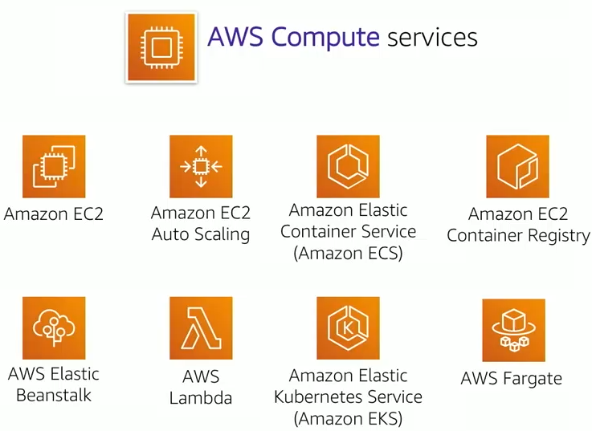
AWS Compute Services

Slide 5
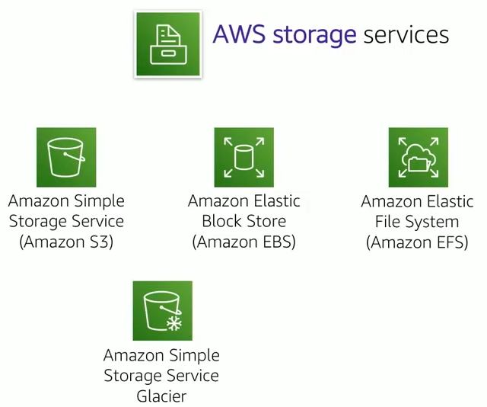
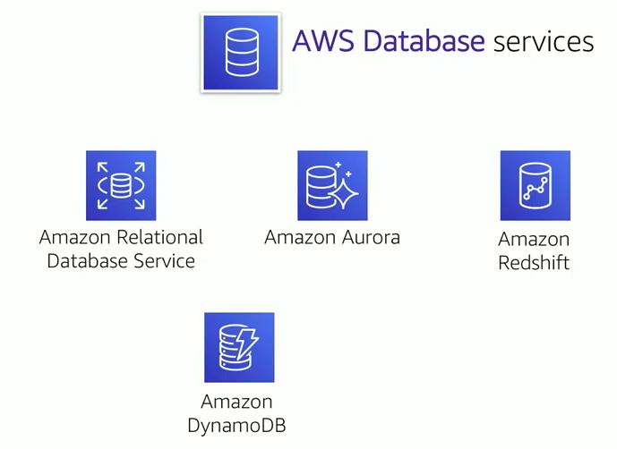
AWS Storage and Database Services

Slide 6
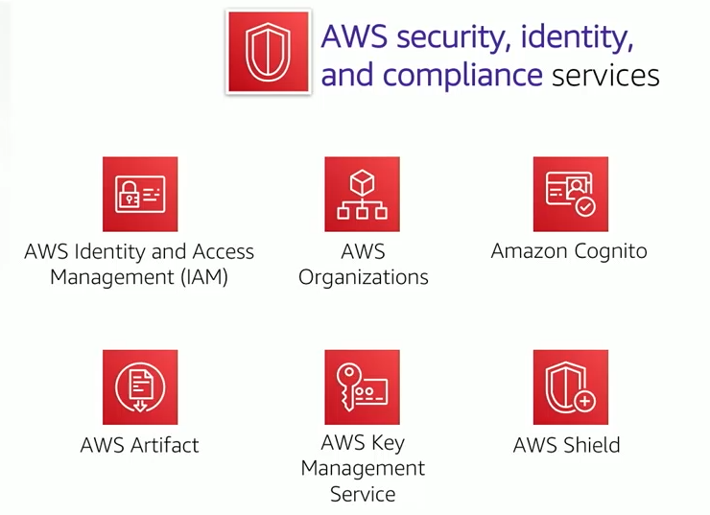
AWS Security and Compliance Services

Slide 7
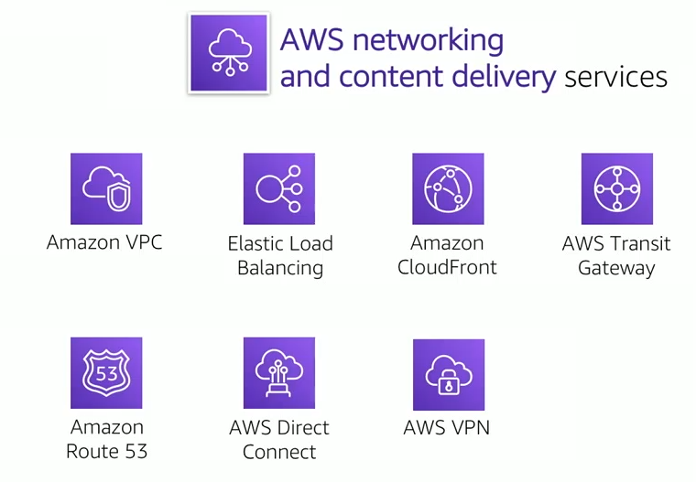
AWS Networking and Content Delivery Services

